Slide 1
International Computer Based Testing Test Center Training

Slide 2
Demonstration of Examinee Workstation: Examinee Functionality

Slide 3
Examinee Functionality – Getting Started
To start an examinee test session, click on the PSI Secure Browser icon on the examinee workstation desktop.
Notes:
At the beginning of your testing day, you will need to start the PSI Secure Browser on each examinee workstation. The application should have been installed on each examinee workstation during the technical readiness setup. There are only a few steps necessary at each workstation to do this daily set up.
To prepare each examinee workstation for testing, click on the PSI Secure Browser icon found on the desktop.

Slide 4
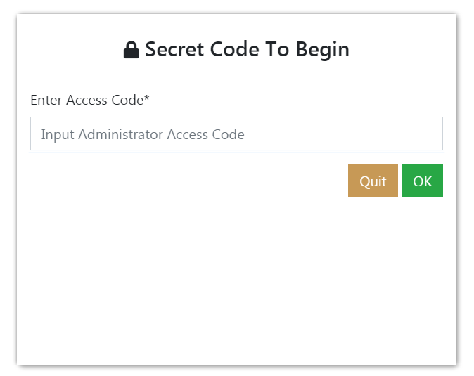
Examinee Functionality – Enter the PSI Access Code
Important:
Never allow the examinee to see the PSI Access Code.
Notes:
As a security precaution, whenever the PSI Secure Browser is started, you will need to enter the PSI Access Code provided to you by ACT. The PSI Access Code was provided in your test centers Readiness email.
IMPORTANT: You must ensure the PSI Access Code is kept secure and never allow examinees to see it or be able to learn it.

Slide 5
Examinee Functionality – System Checks Workstation Configuration
This screen shows that your examinee workstation is properly configured. If not, instructions will be given on this screen to resolve.
Notes:
After entering the PSI Access Code, the PSI Secure Browser checks the environment on the testing workstation to make sure it meets system requirements and allows for a secure testing environment.
This screen shows that your examinee workstation is properly configured. If not, instructions will be given on this screen on how to resolve any issues.

Slide 6
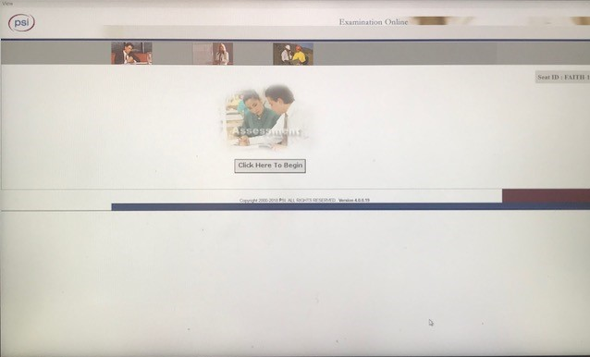
Examinee Functionality – Examinee Workstation Ready
When this screen is displayed, enter Control-T, then click on the Close button.
Notes:
When this screen is displayed, enter Control-T, then click on the Close button. The examinee workstation is now ready for the examinee.
When examinees are seated, they will select the Click Here to Begin button, enter the credentials supplied by the proctor and begin their test.

Slide 7
Test Center Training
Examinee Score Reporting

Slide 8
Examinee Score Reporting
Examinees will be able to view multiple choice test scores by accessing their MyACT student account within 48 business hours of testing in general.
A possible exception to this timeline is if a test is placed on hold due to an irregularity or incident.
The full score report, including the writing test score (for examinees who took the ACT with Writing), will be available through the examinee’s MyACT account approximately 2-8 weeks after testing.
Notes:
Multiple choice score reports from testing completed on computers will receive testing results faster than administrations completed on paper. As a result, examinee multiple choice scores will be available within 48 business hours of testing through the examinee’s online account at myact.org. Full score reports, including the essay score for examinees who took the ACT with Writing are available between 2 and 8 weeks following testing.

Slide 9
Important Information!

Slide 10
Reminders
Only use the Upload Data button at the end of the testing day – not during testing or at the end of a morning session if you have an afternoon session. If you do, no further testing will be possible on that day.
Process for use when terminating a test – make sure student first advances to next section or question.
Monitor for USB storage devices and set PC policy to prevent use of USB storage devices.
Use session functions at the top of proctor screen, which affects all examinees, only with great caution.
Do not use the Score Report function at bottom of Proctor Candidate screen.
Apple Mac PCs must be configured to disable the right-click or secondary click feature.

Slide 11
ACT Contact Information
ACT International Computer-Based Testing Webpage:
https://www.act.org/content/act/en/products-and-services/the-act/international-cbt.html
Phone: +1.319.337.1526
Following the greeting:
For Test Administration: Press 1 to connect to ACT Test Administration
For Technical Support: Press 2 to connect to PSI
Email:
Test Administration: OSUS@act.org
Technical Support: install@psionline.com
Chat:
PSI Technical Support: https://techsupportchat.psiexams.com/techsupportchat/indexact.jsp
Notes:
The ACT-hosted International Testing Website has all the resources you’ll need to successfully administer the ACT test.
If the resources posted on the website do not answer your questions, please call us at or email us using the contact information on the screen.

Slide 12
Thank you for joining us!
All recipients of ACT data and student information are reminded that they are responsible for protecting the confidentiality of that information in accordance with applicable laws and institutional policies. Score recipients assume responsibility for protecting the confidentiality of ACT data reported to them.
© ACT 2021 PT03005.CJ7855
Notes:
Thank you for being here today.

